Slide 1


FishTank Ltd
Well Architected Solution for PETRA

Slide 2
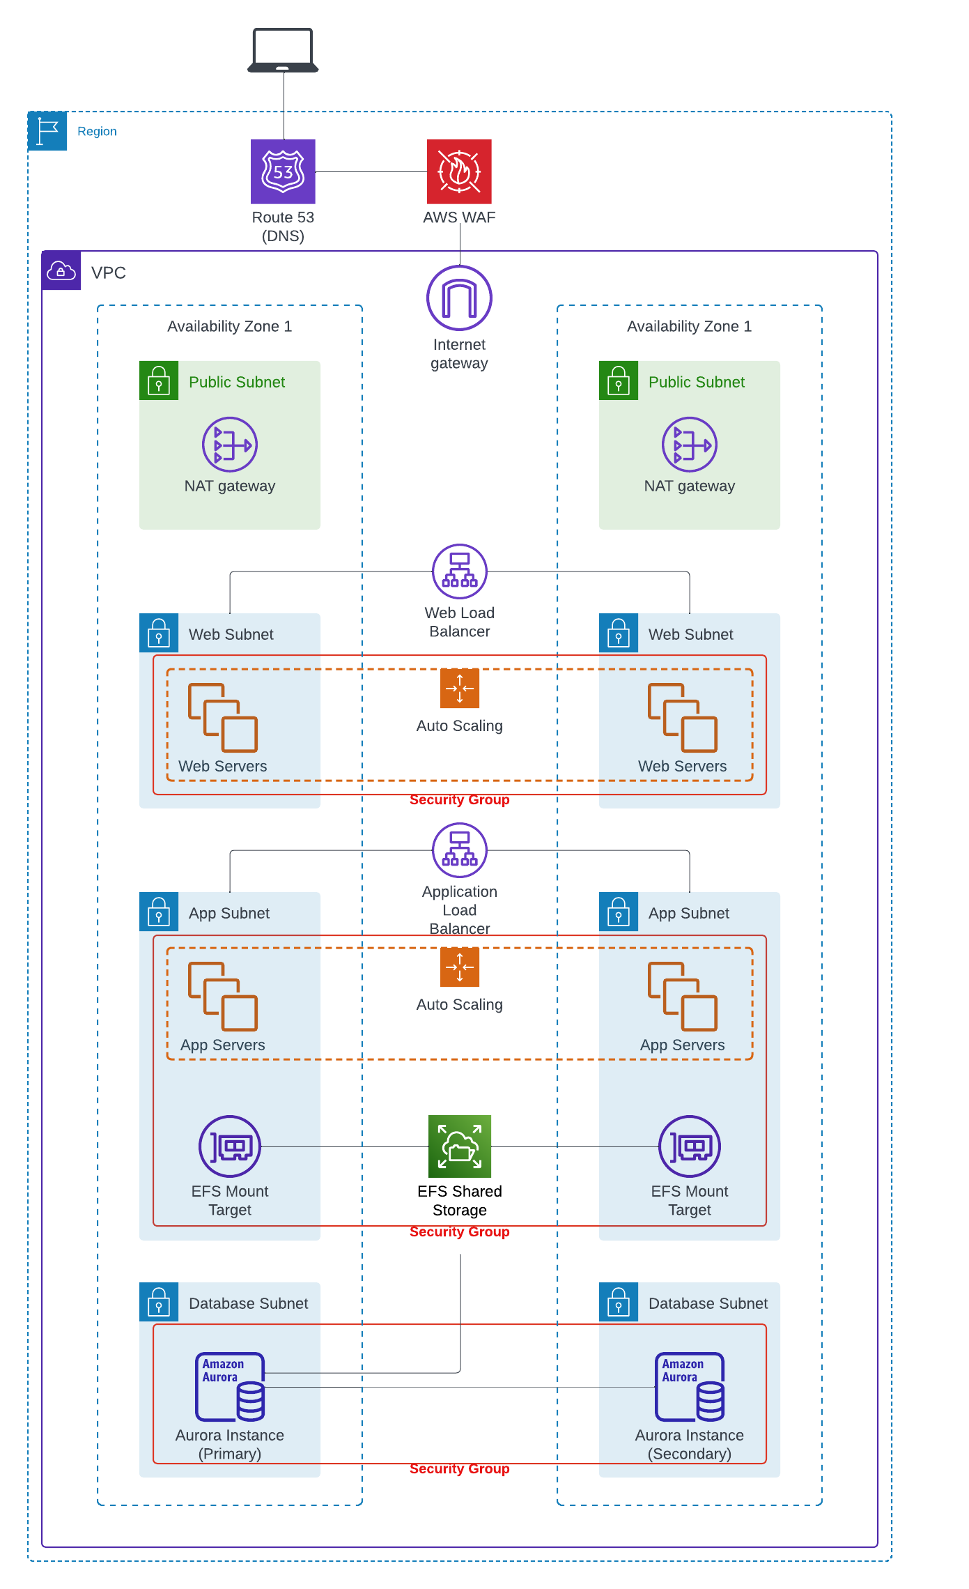
Previous Schematic Diagram
Considering Security…
Lack of Attack protection
Should include a strong identity foundation
Considering Sustainability…
Lacking tools to measure impact of the cloud work-load
Should utilize newer, more efficient software solutions
Should utilize managed services
Should minimize idle resources – eg DB instances
Considering Operational Excellence…
Should implement observability with actionable alerts configured
Should utilize managed services – To reduce operational burden
Considering Reliability…
Resources should be monitored – With alarms to alert on failures
There should be a plan for disaster recovery and data should be backed up
Considering Performance Efficiency…
Could utilize caching
Should monitor workload to ensure compute is optimized
Considering Cost Optimization…
Should measure and analyze expenditure – Identify unexpected costs

Slide 3
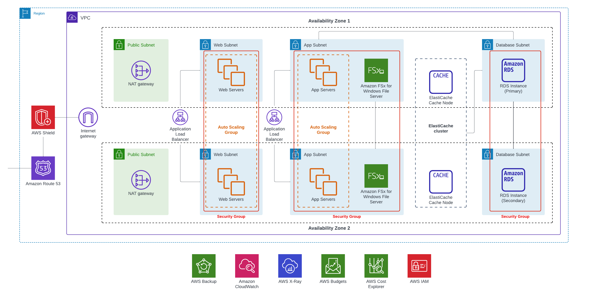

New Schematic diagram
Read Replica

Slide 4




Security Benefits
AWS Shield: Provides managed protection against large and sophisticated DDos attacks
Security groups: Security groups used for web servers, app servers and the database instances. With principle of least privilege this provides an extra layer of security
AWS Organizations: Helps more easily manage policies for groups of accounts and ensure the principle of least privilege is implemented
Notes:
https://aws.amazon.com/iam/resources/best-practices/

Slide 5


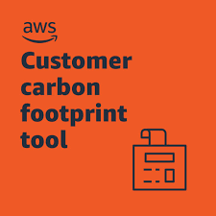
Sustainability Benefits
Utilized managed services such as RDS. This minimizes environmental impact as it is distributed across many users
AWS Customer Carbon Footprint Tool: This tool makes it easy to measure & report, and plan for the future
CloudWatch to identify idle resources and automate actions such as shutting down or resizing to minimize environmental impact

